Slide 1

What’s In A Name?

Slide 2

Sunday, April 10, 2005

Slide 3

“There isn’t anything in a name!”

Slide 4


Slide 5
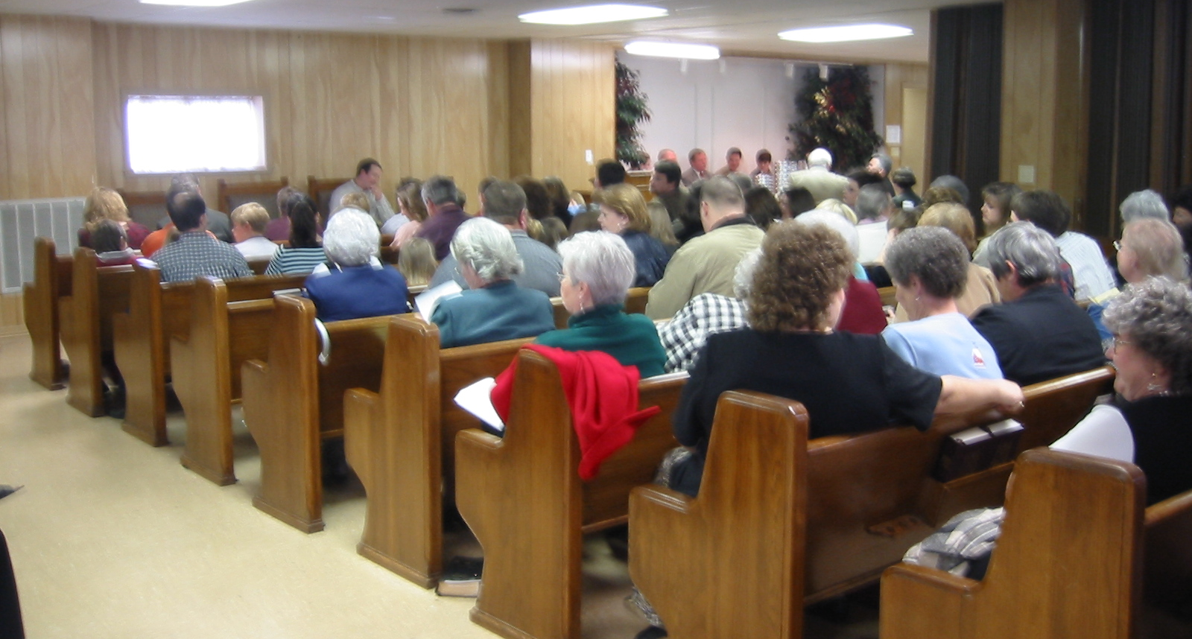

Slide 6
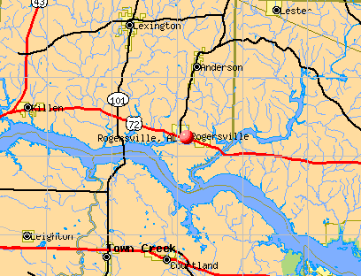
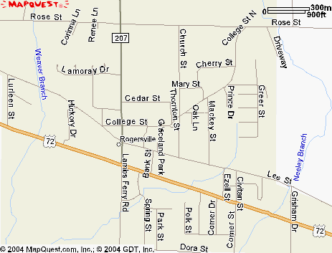
1. Denominationalism defined

Slide 7
1. Jesus’ Attitude Toward Division

Slide 8

1. Jesus’ Attitude Toward Division

Slide 9

1. Jesus’ Attitude Toward Division
John 17:20-21
“that they may all be one”

Slide 10
1. Jesus’ Attitude Toward Division
He prayed that there be a “oneness”
plan, purpose, effort, relationship
John 17:20-21

Slide 11
1. Jesus’ Attitude Toward Division
He prayed that there be a “oneness”
John 17:20-21
all disciples united in faith and worship as found in the New Testament

Slide 12
1. Jesus’ Attitude Toward Division
A “oneness” that would be visible
John 17:20-21
“that the world may believe”
Notes:
2. (4) and (5)

Slide 13
Notes:
2. (6)

Slide 14
1. Jesus’ Attitude Toward Division
John 17:20-21
Notes:
2. (7)

Slide 15

Ephesians 1:22-23

Slide 16
3. The Question of ______ as Related to Division

Slide 17
3. The Question of Name as Related to Division
What shall be the name of this united church?

Slide 18
3. The Question of Name as Related to Division
Has God already provided a name for His church and His people?
Has He left the matter of naming His church and His people to the people themselves?
Notes:
3. (2)

Slide 19
3. The Question of Name as Related to Division
Acts 15:18
“the eternal purpose” of God
“Known unto God are all his works from the beginning of the world.”
Eph. 1:4-12; Eph. 2:8-12;
1Peter 1:10-12; Rev. 13:8.
Notes:
3. (3)

Slide 20
3. The Question of Name as Related to Division
Acts 15:18
“the eternal purpose” of God
“Known unto God are all his works from the beginning of the world.”
1) Look to the O.T. for prophecy
2) Look to the N.T. for fulfillment
Notes:
3. (3) c.

Slide 21
4. The Teaching of the Old Testament Regarding The Name
Isaiah 65:15
Isaiah 62:2
Isaiah 56:5
Amos 9:11-12

Slide 22
5. The Teaching of the New Testament Regarding The Name
Acts 11:26
Acts 15:14
“… to take out of them a people for his name”

Slide 23
5. The Teaching of the New Testament Regarding The Name
Acts 11:26
Acts 26:28
2 Peter 4:16
Colossians 3:17

Slide 24





5. The Teaching of the New Testament Regarding The Name
Notes:
5. (4) c

Slide 25
5. The Teaching of the New Testament Regarding The Name
Philippians 2:9-11
… a name which is above every name…

Slide 26
5. The Teaching of the New Testament Regarding The Name
2Cor. 11:2; Rev. 21:2
. . . the church is
the bride of Christ

Slide 27
5. The Teaching of the New Testament Regarding The Name
Acts 4:12
… salvation in no other name …

Slide 28
5. The Teaching of the New Testament Regarding The Name
Acts 15:17
… into whose name is one baptized?
Matthew 28:19; Acts 2:38
Notes:
5. (9)

Slide 29
5. The Teaching of the New Testament Regarding The Name
Rev. 2:13; Rev. 3:8
The churches at Pergamum and Philadelphia were commended because…
they kept His name
and His word.

Slide 30
A. J. Gordon (Baptist)
Selected Northfield Sermons
Charles Haddon Spurgeon (Baptist)
Spurgeon Memorial Library, Vol I, p. 168.
Martin Luther (Catholic Reformer)
Charles Stork, Life of Luther, p. 289.
John Wesley (Methodist)

Slide 31

TO BE SAVED ETERNALLY . . .
BANK OF HEAVEN
The Lord’s name is the only name which has any credit at the Bank of Heaven!

Slide 32
Augusta, Georgia

Slide 33

TO BE SAVED ETERNALLY . . .
The Lord’s name is the only name which has any credit at the Bank of Heaven!

